Slide 1

JavaScript performance
Because it matters

Slide 2
Should we care about JavaScript performance?
Some people think - no

Slide 3
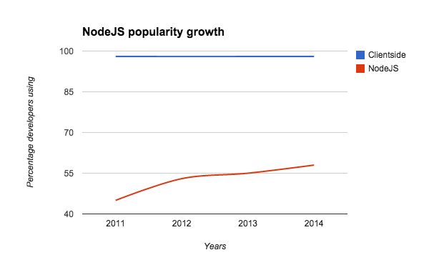
Big data and server side matters

Slide 4

Measurement
TimeEnd - TimeStart = ExecTime

Slide 5

performance.now()
Like a Date.now() in microseconds

Slide 6

How JavaScript
engine works?
Because engineer should
know how

Slide 7
Levels of JS engines optimization
Compiles JavaScript to native code via JIT
Creates hidden classes during run time to optimize access to objects
Functions optimizations
Deoptimization if too optimistic

Slide 8
Why JIT
was a game changer?
Classic interpretation flow:
JavaScript
Lexer
Parser
Translation
Interpreter
Native code
TOKENS
SYNTAXTREE
BYTE CODE

Slide 9

Lexer cuts JS code
Tokens samples: [1,2,’abc’], 1,
‘abc’, instanceof

Slide 10

Parser builds tree
Which describes how tokens
are connected and inherited

Slide 11
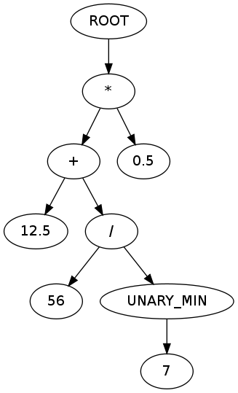

Slide 12

Translator converts
to byte code
Simpliest translator looks like
dirctionary of bytecode
commands or big switch operator

Slide 13

Interpreter
Converts byte code to native
and executes it. This takes a bunch of time every time you need to run some code

Slide 14
JIT
=
Just in time compilation

Slide 15

Challenge started
V8 vs SpiderMonkey vs Nitro

Slide 16

Hidden classes
Because JavaScript still
have a static typed soul

Slide 17
Always give browser a hint on a class expected
Bad | Good
var year; … year = 1985; | var year = 1985;

Slide 18

Inline caching
Keeping hidden classes
for further use

Slide 19
Define class properties in constructor
Bad | Good
var myClass = function(){}; … myClassInstance.left = 20; | var myClass = function(){ this.left = 10; }; … myClassInstance.left = 20;

Slide 20
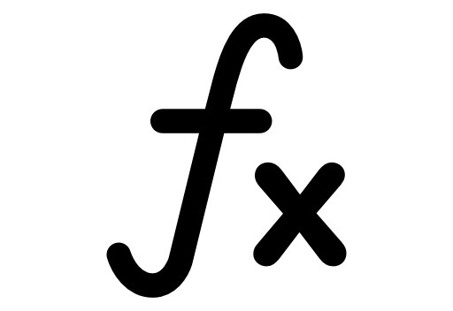
Functions inlining
Call replacement by body

Slide 21
Use small monomorphic functions
Bad | Good
function myFunc(){ ...100 lines } myFunc(1); myFunc([1,7,12,9]); | function myFunc(){ ...10 lines } myFunc(1); myFunc(12);

Slide 22
No nested functions
Since you redeclare
inner functions on every call

Slide 23

Fast numbers
Small integers vs doubles
15 - SMI (fast, value)
15.5 - double (slow, pointer)

Slide 24

Fast arrays /
slow hashtables
Array start with 0, have no gaps
Fast array contains only one type,
Faster array contains SMI

Slide 25
Prefer arrays over objects working with big data
The only excuse is a need to access by string index / key

Slide 26
Preallocate arrays < 64k
var arr = new Array(1000);
is a way faster than
var arr = [];

Slide 27
Other optimizations:
Hoisting out of the loop
for (var i = 0; i < arr.length),
arr.length will be calculated only once since browser now it should be hoisted

Slide 28
Other optimizations:
Constants folding
Caching of immutable data in order to calculate only once.

Slide 29
Other optimizations:
Dead code elimination
Let`s delete useless code

Slide 30

Caching,
memoization
Fastest way to accomplish task
is to skip it

Slide 31
Querying selector with caching
function searchNoCaching(selector) {
return document.querySelectorAll(selector),
}
function searchWithCaching(selector) {
return searchCache[selector] = searchCache[selector] || document.querySelectorAll(selector),
}
var searchCache = {};

Slide 32

jQuery is beautiful
Do not use it

Slide 33
Why not?
100 Kb on mobile? Come on!
Performance - sometimes 40 times slower comparing to native
Missing the future - native analogues evolving, becoming more and more performant. By sticking to jQuery you are missing cutting edge.

Slide 34
DOM is the bottleneck, write less to it
Append less to the actual document, use temporary in-memory nodes to accumulate changes and insert all at once then.

Slide 35
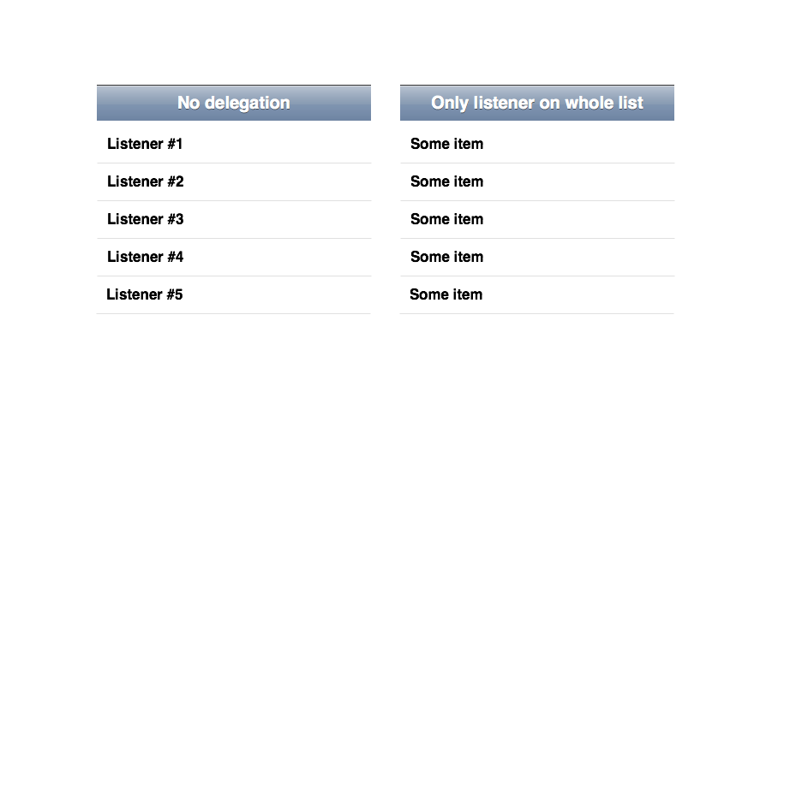
Events delegation

Slide 36
Check list
Define variable type initially
Define class properties in constructor
Integers are faster
Write small monomorphic functions
Avoid nested functions declaration
Use arrays starting from 0 index without gaps
All elements of array shoud have the same type, SMI is preferable

Slide 37
Check list
Do not use objects for big data unless you need key based access
Cache / memoize heavy calculations
Do not use jQuery
Write to the document`s DOM as less as possible
Use event delegation in lists

